Slide 1

Carthage DEV Solution Type: Prototype
Wassim Selmi
Sayf eddine Khnissi
Notes:
Korrie

Slide 2

The Opportunity
In today's reality, dining out can be a fearful experience instead of a joyful one for millions grappling with allergies and health conditions. The increasing prevalence of food allergies and dietary restrictions is impacting individuals and families globally. Recent data indicates a steady rise in the number of people affected by these conditions, altering the way they navigate everyday experiences, especially when it comes to dining choices.
Notes:
Korrie
updated 7/21

Slide 3

The Opportunity
Let's walk in the shoes of someone with a severe allergy or health condition. Every meal becomes a minefield, a gamble with potentially severe consequences. The lack of accurate information on menus, cross-contamination risks, and limited dietary options pose significant challenges. This not only affects the customers but also impacts businesses that could potentially cater to this market. But where there are challenges, there are also opportunities.
Notes:
Korrie
updated 7/21

Slide 4
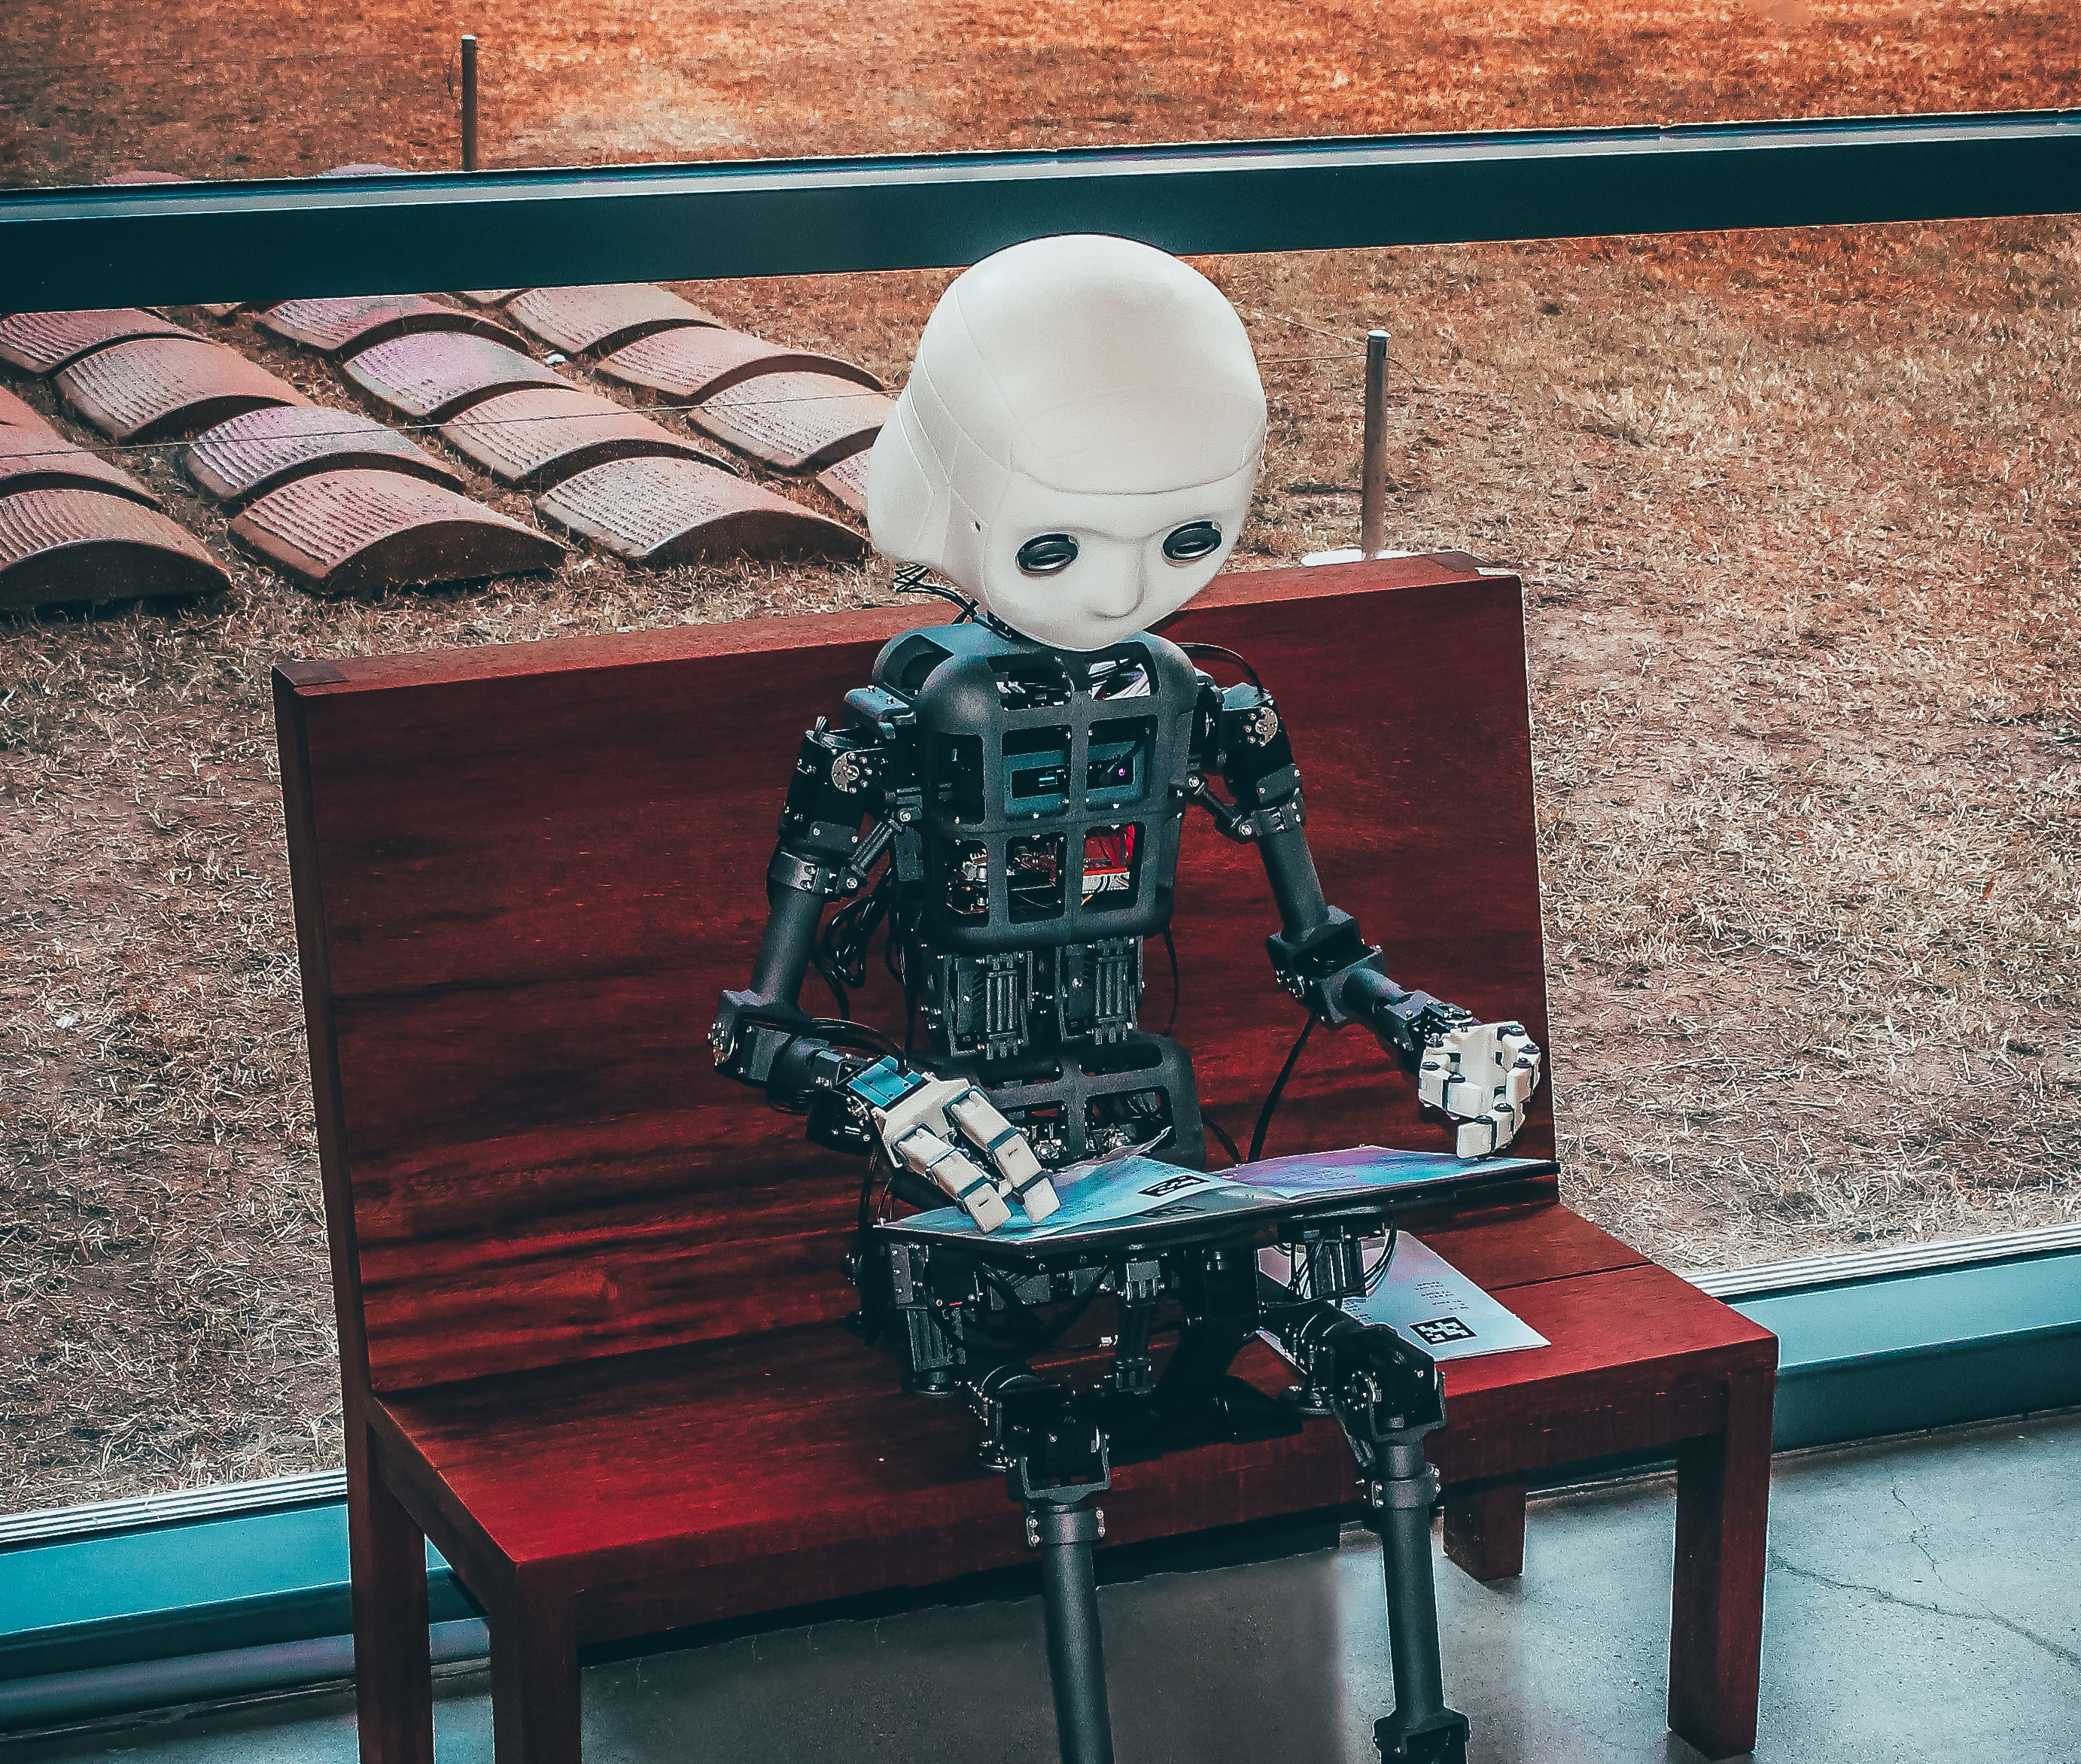
The Opportunity
SafeBite injects fresh perspectives and cutting-edge technology into their established systems. We're not just here to address existing problems; we're here to foresee and solve problems customers might not even realize they have yet.
It's about making a tangible difference in people's lives. By partnering with SafeBite, companies position themselves as pioneers in creating a safer, more inclusive world for their customers. It's not just a service; it's a commitment to a healthier, happier community.
Notes:
Korrie
updated 7/21

Slide 5
Solution
We built SafeBite because we recognized a critical need in society: the struggle faced by individuals dealing with food allergies and health conditions when dining out. Our motivation stemmed from empathy and a desire to transform this challenging experience into one that's safe, enjoyable, and inclusive for everyone.
Notes:
Korrie
updated 7/21

Slide 6

Solution
SafeBite addresses the pain points of individuals by offering a comprehensive solution that empowers them to make informed dining choices. We provide detailed information on allergens, dietary preferences, and restaurant-specific accommodations. By collating and presenting this crucial data through our app, we aim to alleviate the stress and uncertainty that accompany dining out for those with dietary restrictions.
Notes:
Korrie
updated 7/21

Slide 7
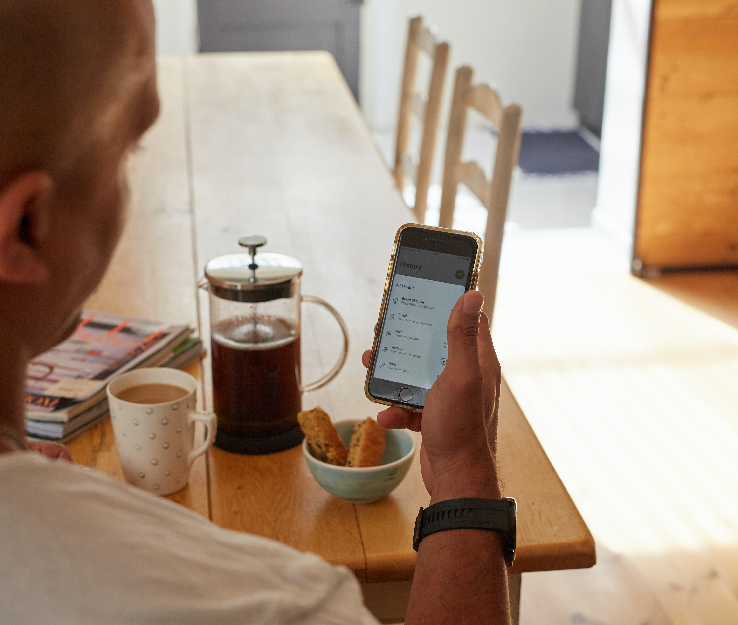
Solution
In the realm of technology-driven dining solutions, SafeBite fits into the category of transformative disruptors. We aim to revolutionize the way individuals with dietary restrictions experience dining, carving a niche in an emerging market segment that's increasingly prioritizing inclusive dining experiences.
What Sets Us Apart:
Comprehensive approach
Continuous innovation
Inclusivity and safety
Notes:
Korrie
updated 7/21

Slide 8
Demo
Important: limit demo length to 1-minute
Pre-recorded demo of solution (Video or animated gif).
Recommend no audio, but talk over the video.
Embed if <10MB, or post link here for us to download.
On occasion, a sequence of screenshots might be preferred.
Notes:
Korrie
updated 7/21

Slide 9

Takeaways
Without our solution, the industry can still progress towards inclusivity, but it would be a slower and more uncertain journey. Businesses and individuals would need to rely on fragmented, less accessible information sources, making it challenging to ensure a consistently safe and accommodating dining experience for everyone.
To our audience, I recommend stopping the perpetuation of exclusionary dining experiences. Start embracing inclusivity and actively supporting solutions that cater to individuals with dietary restrictions. The key is to foster an environment where everyone can enjoy dining out without fear or limitations.
Notes:
Korrie
updated 7/21

